Slide 1
WELLCOME TO OUR CLASS

Slide 2
UNIT 5: CAN YOU SWIM?
Lesson 2
ABILITIES

Slide 3
Warm up
What can you do?
Action Words - Talking Flashcards.mp4

Slide 4
00
01
02
03
04
05
06
07
08
09
10

Slide 5
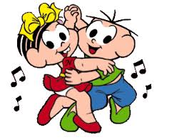
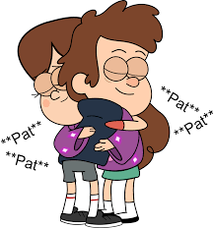
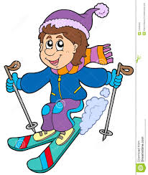
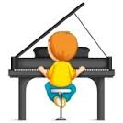
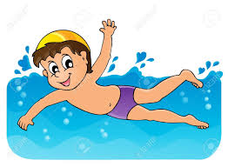
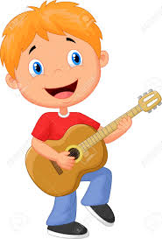
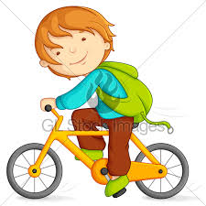

Slide 6
1. Look, listen and repeat

Slide 7
1. Look, listen and repeat
2. Point and say
* Model:
Can you play volleyball?
Yes, I can
No, I can’t
1. Meaning: Bạn có thể chơi bóng chuyền được không?
Có, tôi có thể./ Không, tôi không thể.
2. Usage: Mẫu câu dùng để hỏi xem người đối diện có thể làm gì và trả lời
3. Note: can’t = can not

Slide 8
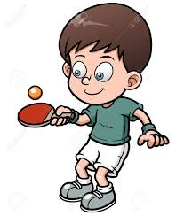
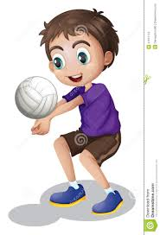
2. Point and say
Yes, I can
No, I can’t
Can you
a. Play table tennis
b. Play volleyball
c. Play the piano
d. Play the guitar

Slide 9
3. Let’s talk
Can you….? | Name:
Play table tennis
Play volleyball
Play the piano
Play the guitar

Slide 10
Can he/she play volleyball?
Yes, he/she can
No, he/she can’t

Slide 11
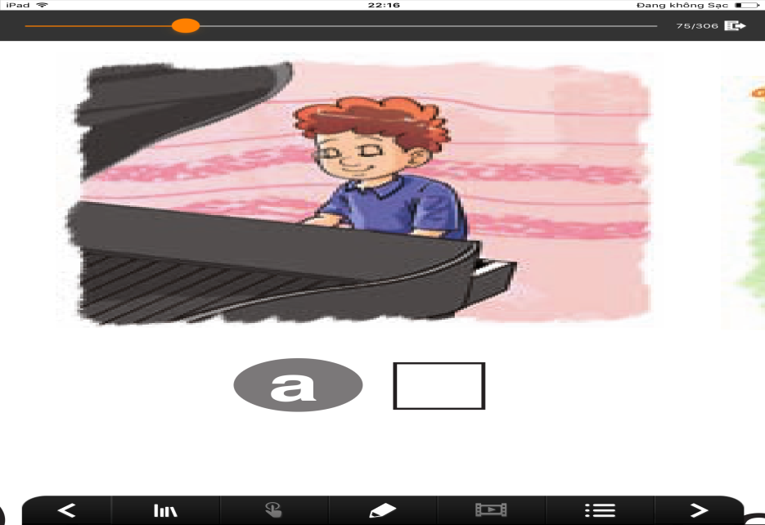
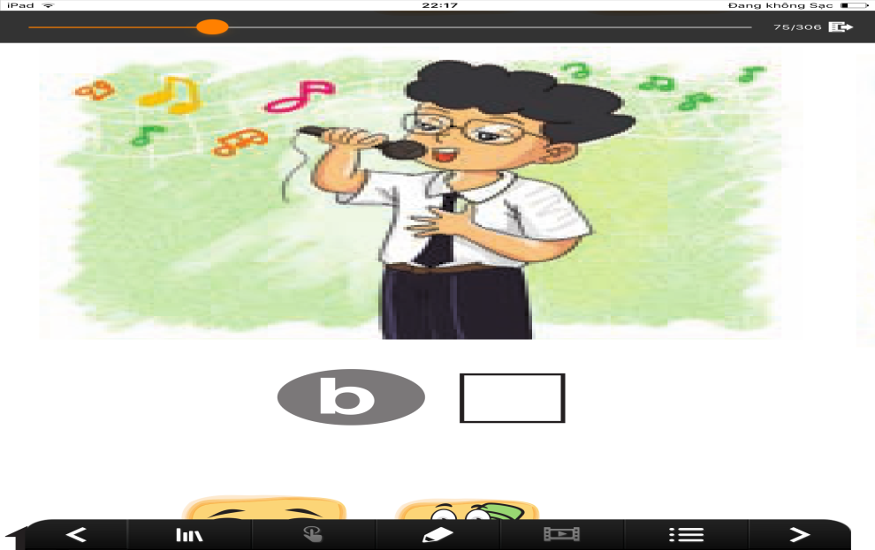
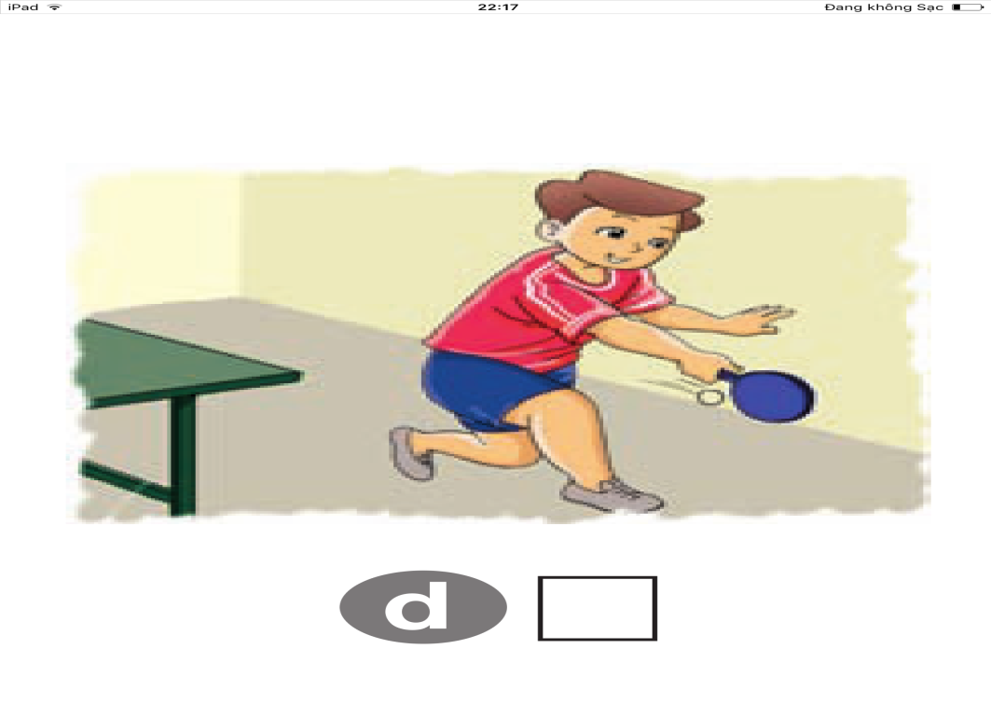
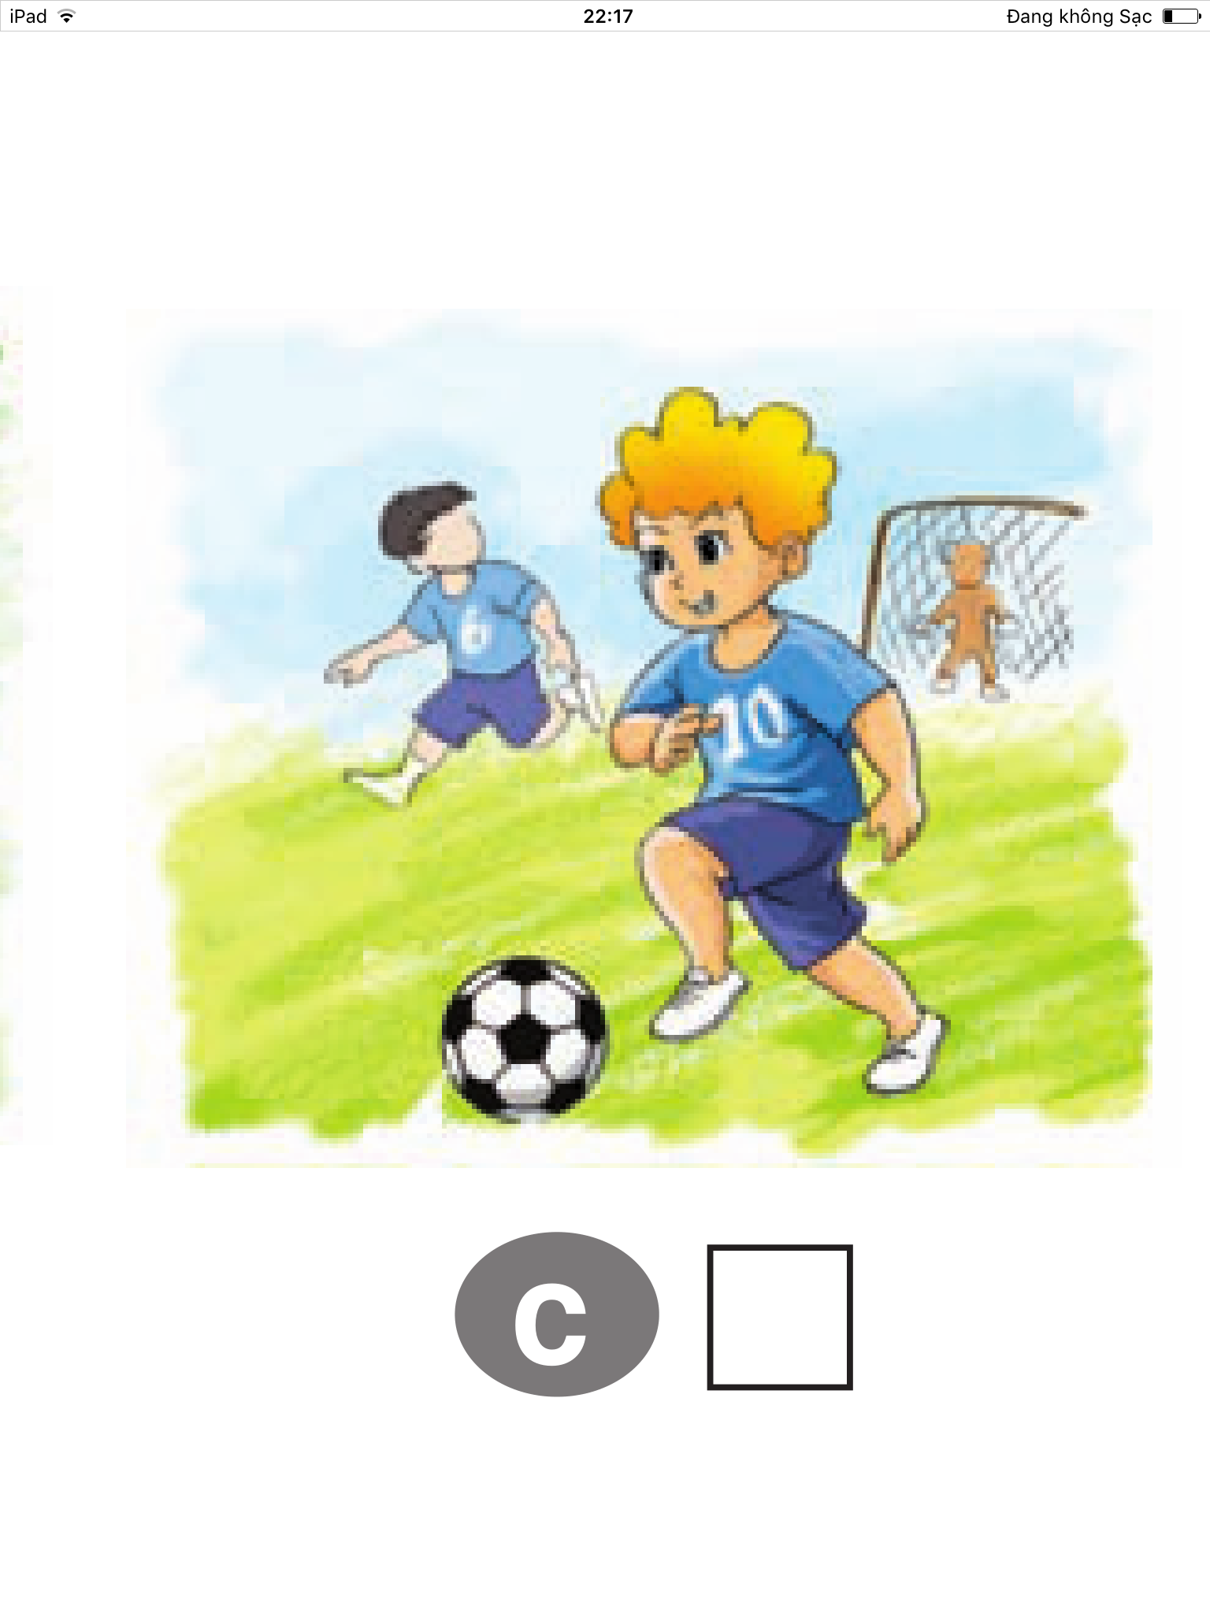
Listen and number
4. Listen and number
2
4
3
1

Slide 12
Game
Game
Can you….?
Yes, I can No, I can’t

Slide 13
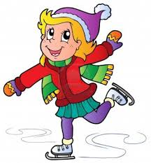
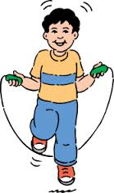
Can you…..?

Slide 14
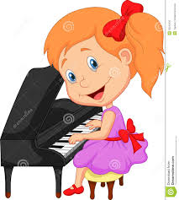
Can he/She….?

Slide 15
Homework
Do exercises in your workbook
Prepare new lesson

Slide 17
Warm up
00
01
02
03
04
05
06
07
08
09
10
What can you do?

